Slide 1
Webscraping Project
Zhu Wang

Slide 2
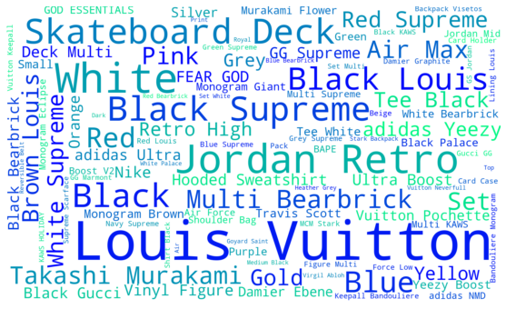
Overview

Slide 3
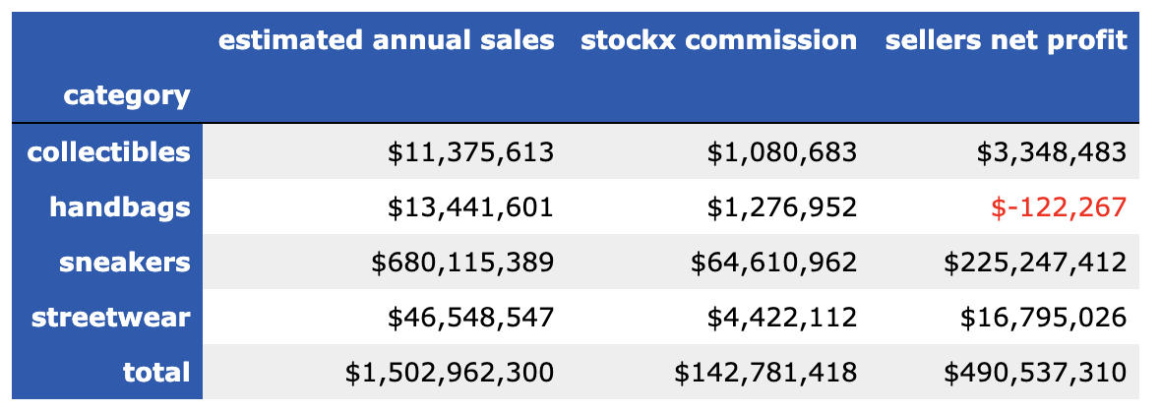
12-Month Financial Snapshot
Assumptions and caveats
StockX commission estimated based on 9.5% transaction fee per item.
Sellers net profit estimated based on average sales price net of cost and StockX fees
The category of watches is excluded for this analysis

Slide 4
12-Month Financial Snapshot

Slide 5
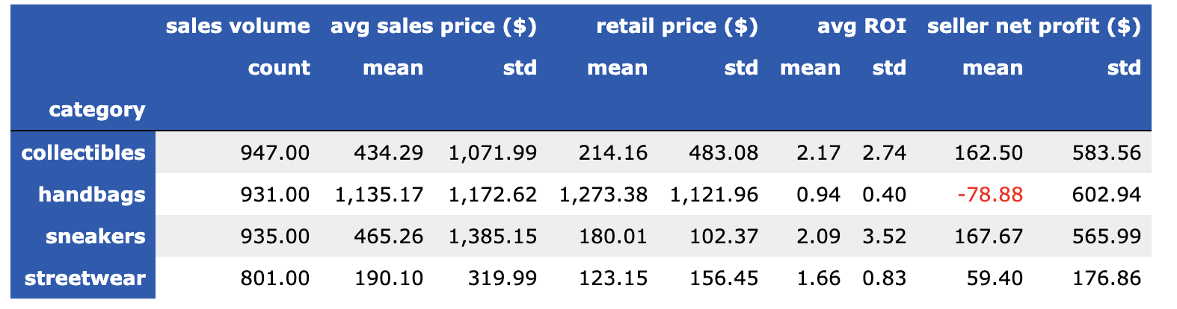
12-Month Financial Snapshot

Slide 6
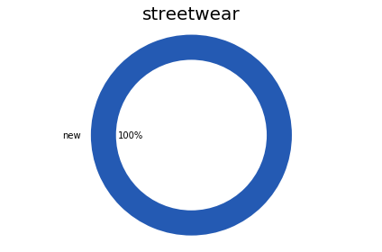
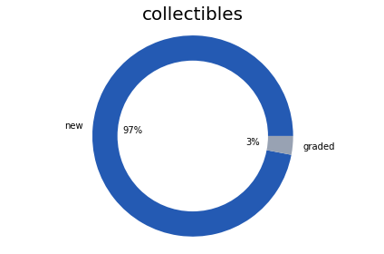

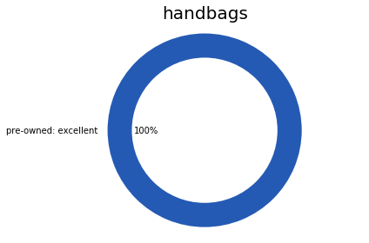
Resale Condition

Slide 7
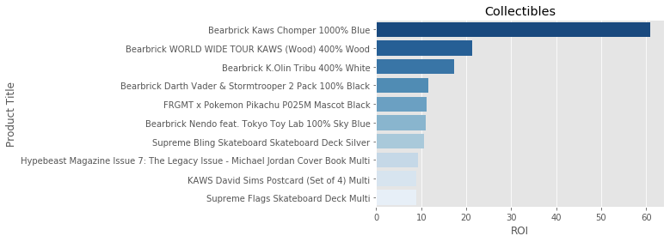
Top 10 Return on Investment (ROI)
Retail $120
Avg Resale: $7,500
Image source: https://stockx.com/

Slide 8
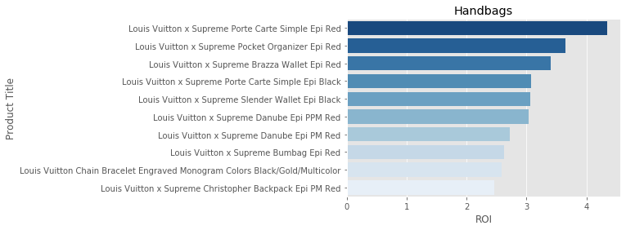
Top 10 ROI
Retail: $305
Avg Resale: $1,328
Image source: https://stockx.com/

Slide 9
Top 10 ROI
Retail: $368
Avg Resale: $3,814
Image source: https://stockx.com/

Slide 10
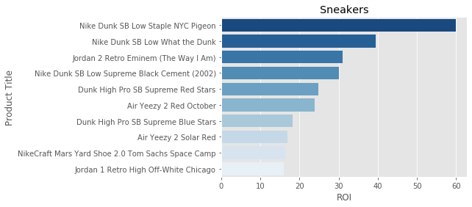
Top 10 ROI
Retail: $200
Avg Resale: $11,965
Image source: https://stockx.com/

Slide 11
Retail, Resale, Avg ROI Comparison
*Log of x-axis taken for ease of visualization
*Include outliers

Slide 12
Retail, Resale, Avg ROI Comparison
*Log of x-axis taken for ease of visualization
**Exclude outliers

Slide 13
Retail vs. Resale Price Distributions
*Log of x-axis taken for ease of visualization
**Include data based on avg ROI within 3σc for each product category

Slide 14
Average ROI Distributions
*Log of x-axis taken for ease of visualization
**Include data based on avg ROI within 3σc for each product category

Slide 15
Buy Low Tops, Sell High Tops

Slide 16
Jordan Example

Slide 17
adidas Yeezy Example

Slide 18
Another Look
*Include data based on avg ROI within 3σc for each brand

Slide 19


Questions?

